Slide 1
Acropolis Fitness
Grigoris Lagos

Slide 2
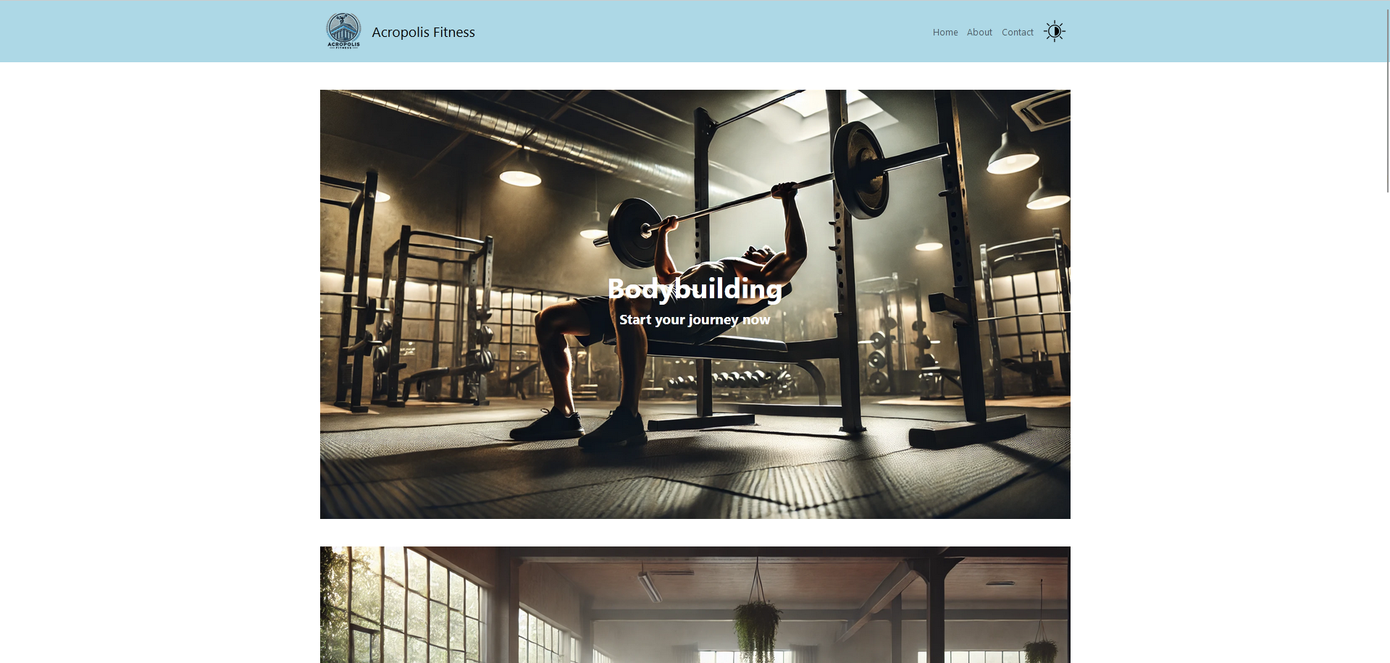

Slide 3
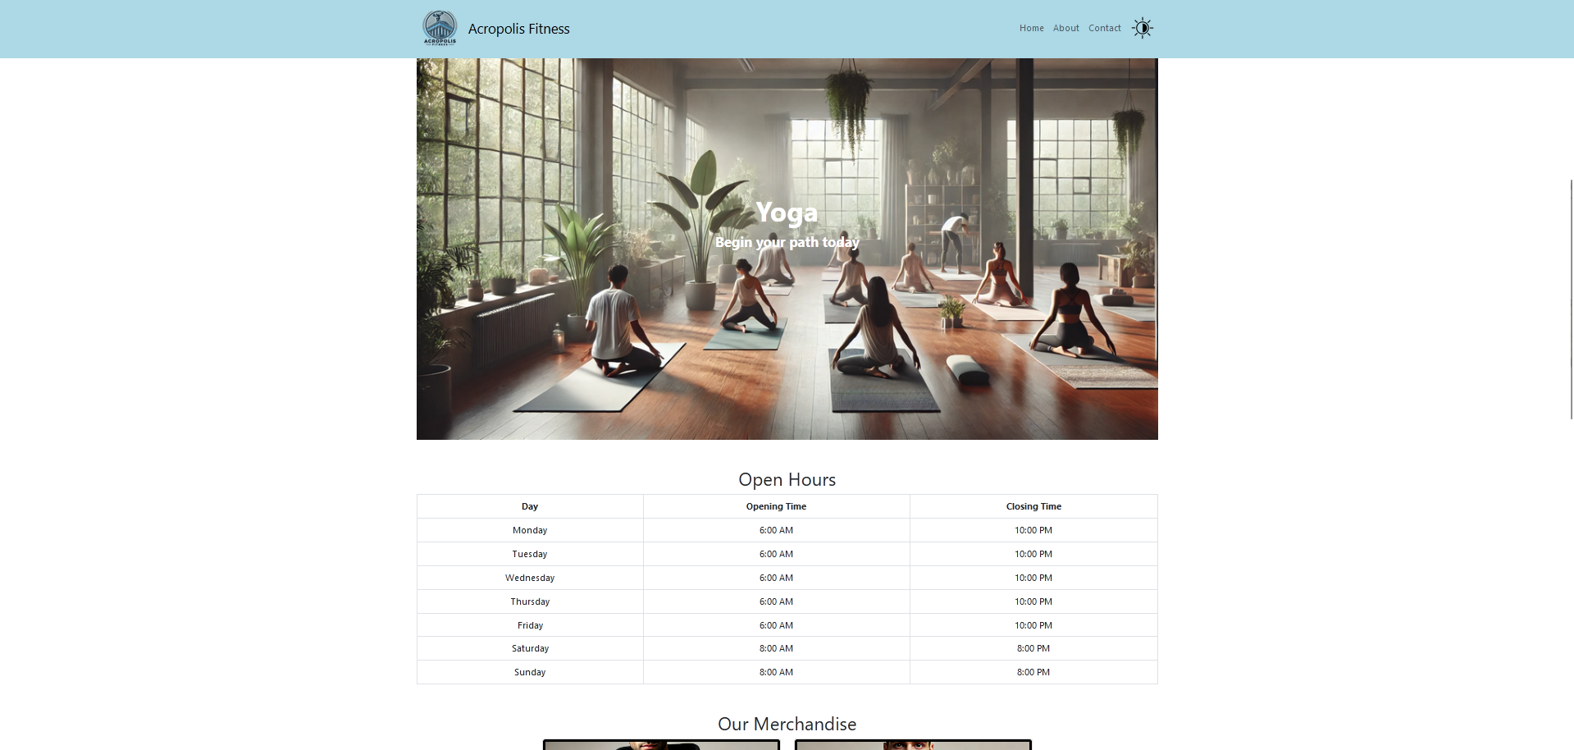

Slide 4
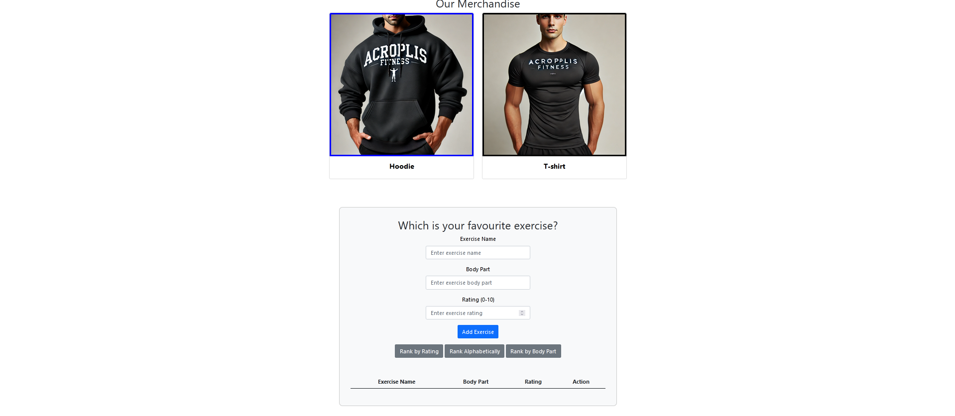

Slide 5
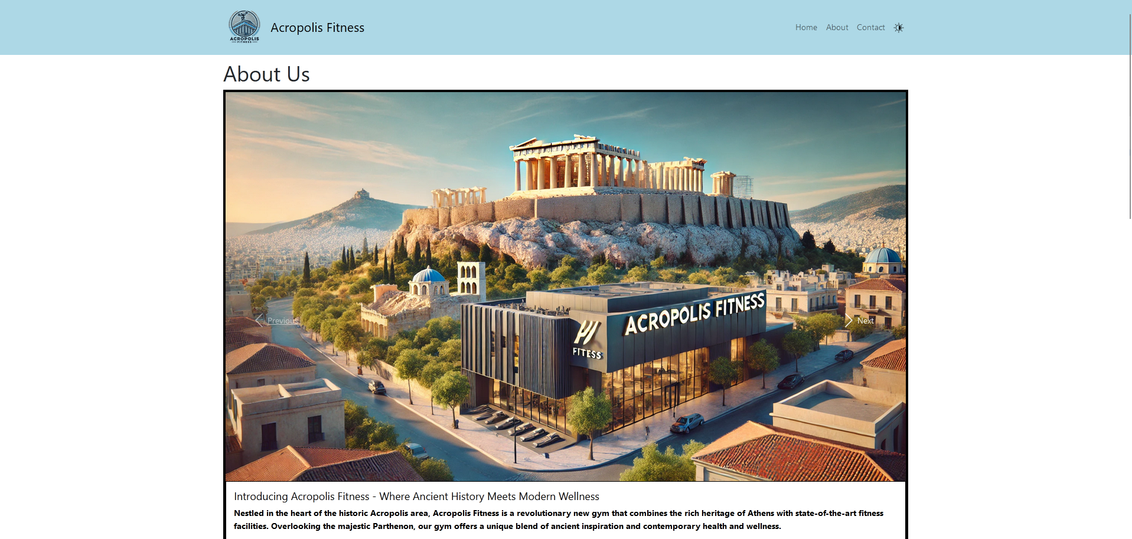

Slide 6
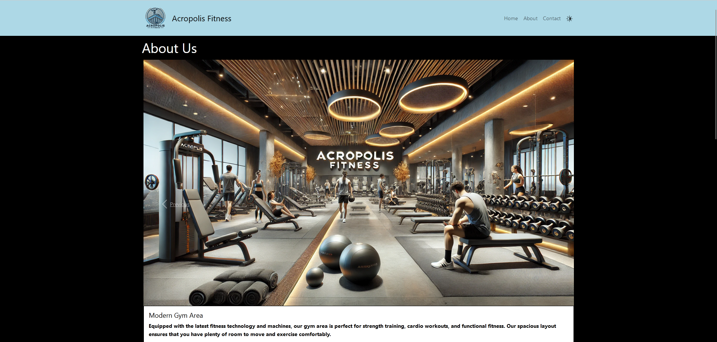

Slide 7
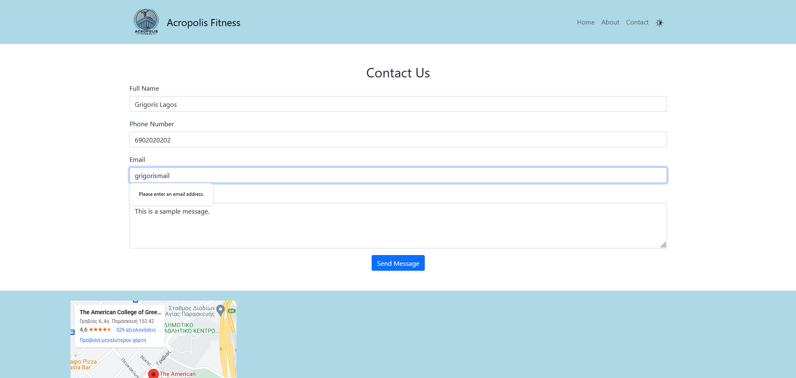

Slide 8
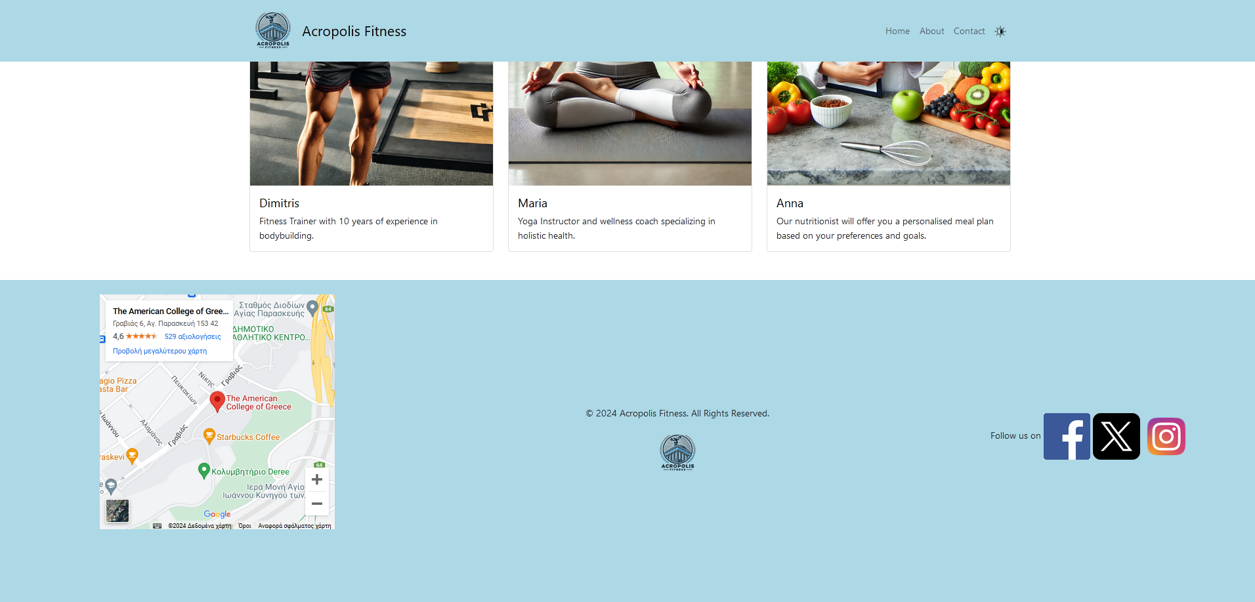

Slide 9
References
All images were generated by OpenAI, along with the company logo
Icons were taken from non-copyrighted sources.

Slide 10
Git repository
https://github.com/grigorislagos/Lagos-Internet-Programming-Midterm-Project.git

